Slide 1
Raspberry Pi Basic
2016. 09. 20.
Jinhyuk Yim (jinhyuk@uns.ajou.ac.kr)
Eungkyu Lee (eungkyu@uns.ajou.ac.kr)

Slide 2
Introduction to Raspberry Pi
Raspberry Pi
Arduino & Raspberry Pi
Raspberry Pi’s OS & model
Raspberry Pi Specification
Raspberry Pi GPIO
Practice

Slide 3
Introduction

Slide 4
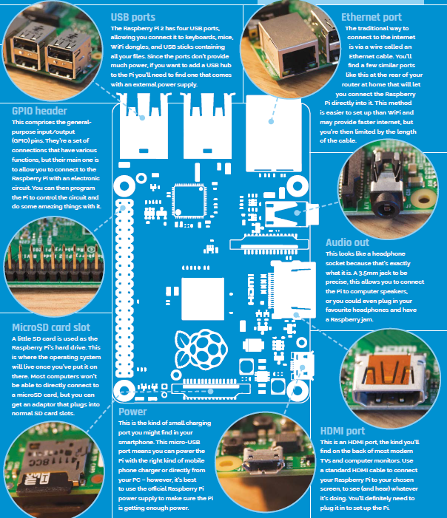
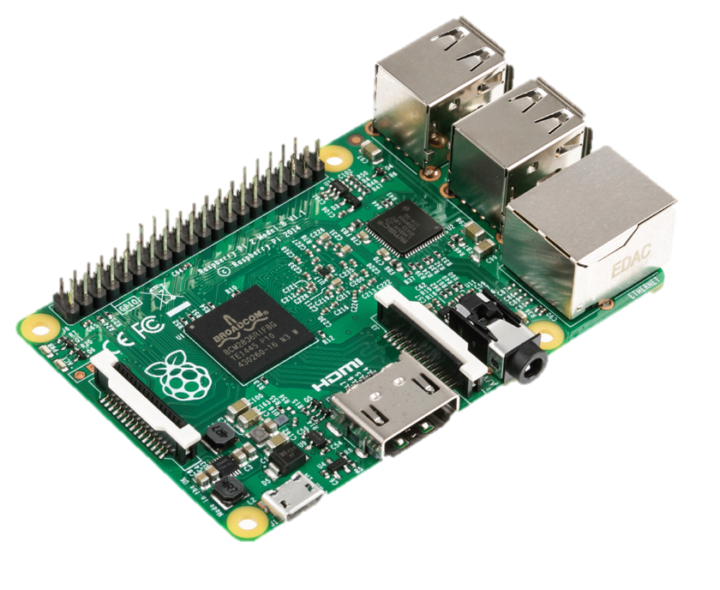
Raspberry Pi
The Raspberry Pi is a single-board computers developed in the United Kingdom by the Raspberry Pi Foundation to promote the teaching of basic computer science in schools and developing countries.

Slide 5
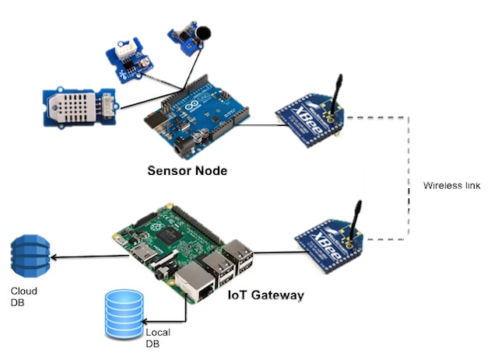
Arduino & Raspberry Pi
 | Arduino Uno | Raspberry Pi
CPU type | Micro controller | Micro processor
Operating System | None | Linux (usually Raspbian)
Disk | 32kbyte | Depends on SD card
Other connectivity | None | USB, Ethernet, HDMI, Audio

Slide 6
Introduction to Raspberry Pi
Operating System
NOOBS
RASPBIAN
UBUNTU MATE
WINDOWS 10 IOT CORE
Hardware Model & Version
Model A (1, 1+)
Model B (1, 1+, 2, 3)
Model Zero (N/A)
Ref : https://www.raspberrypi.org

Slide 7
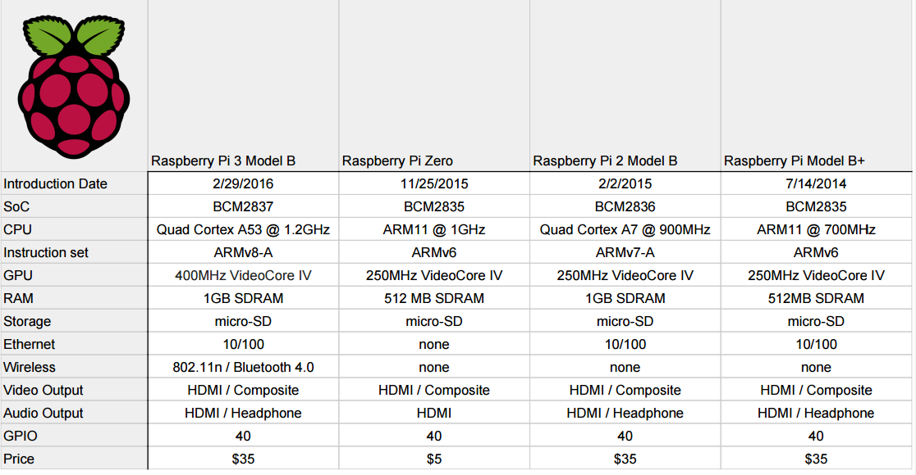
Raspberry Pi Specification

Slide 8
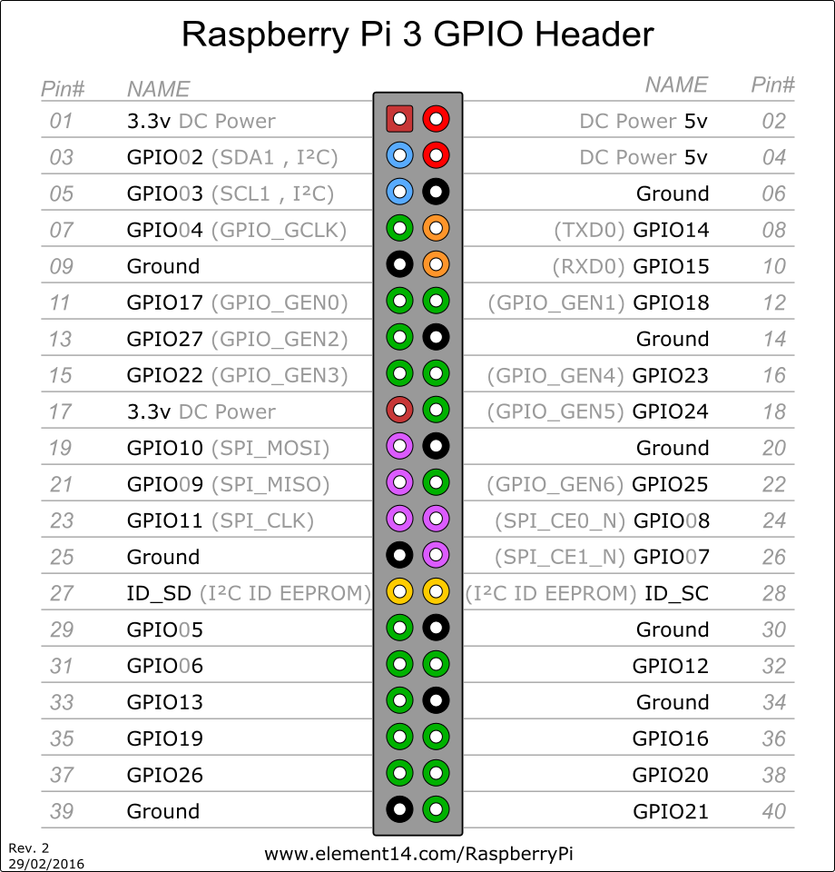
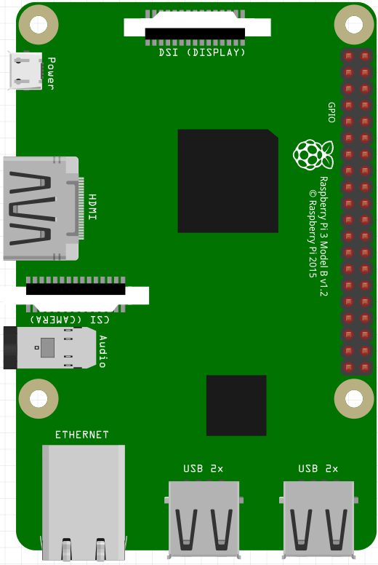
Raspberry Pi GPIO

Slide 9
Practice

Slide 10
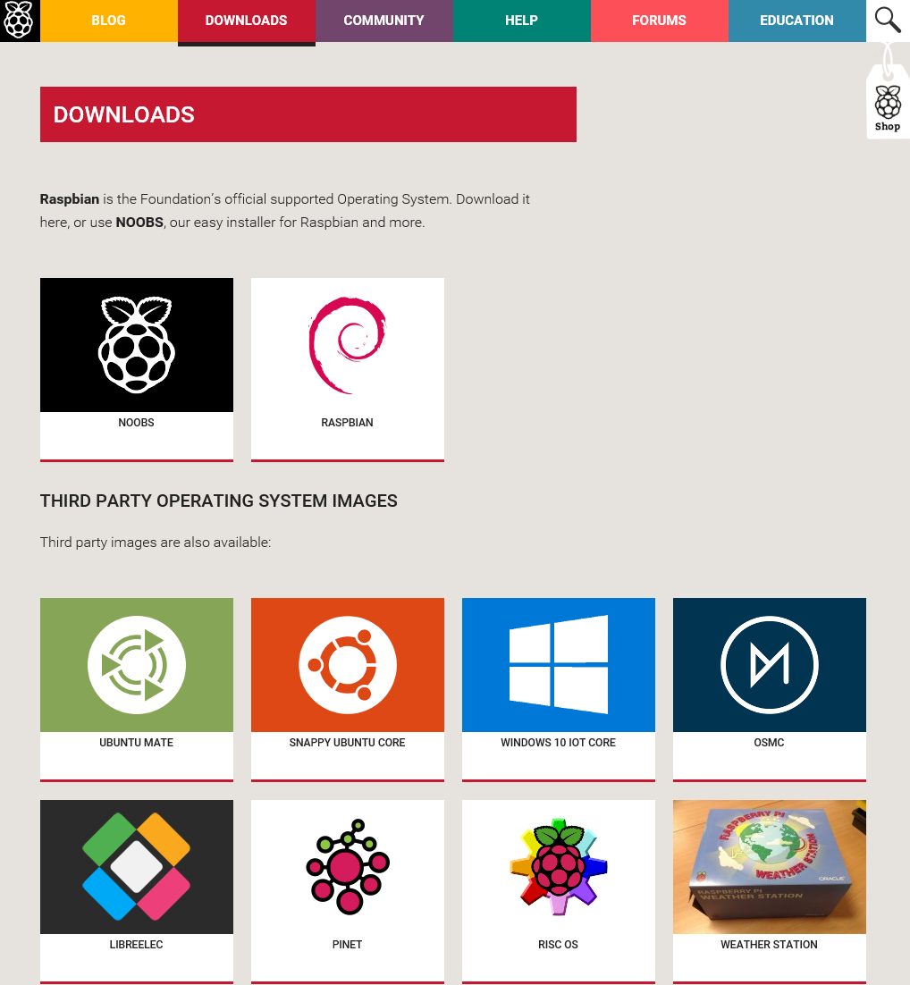
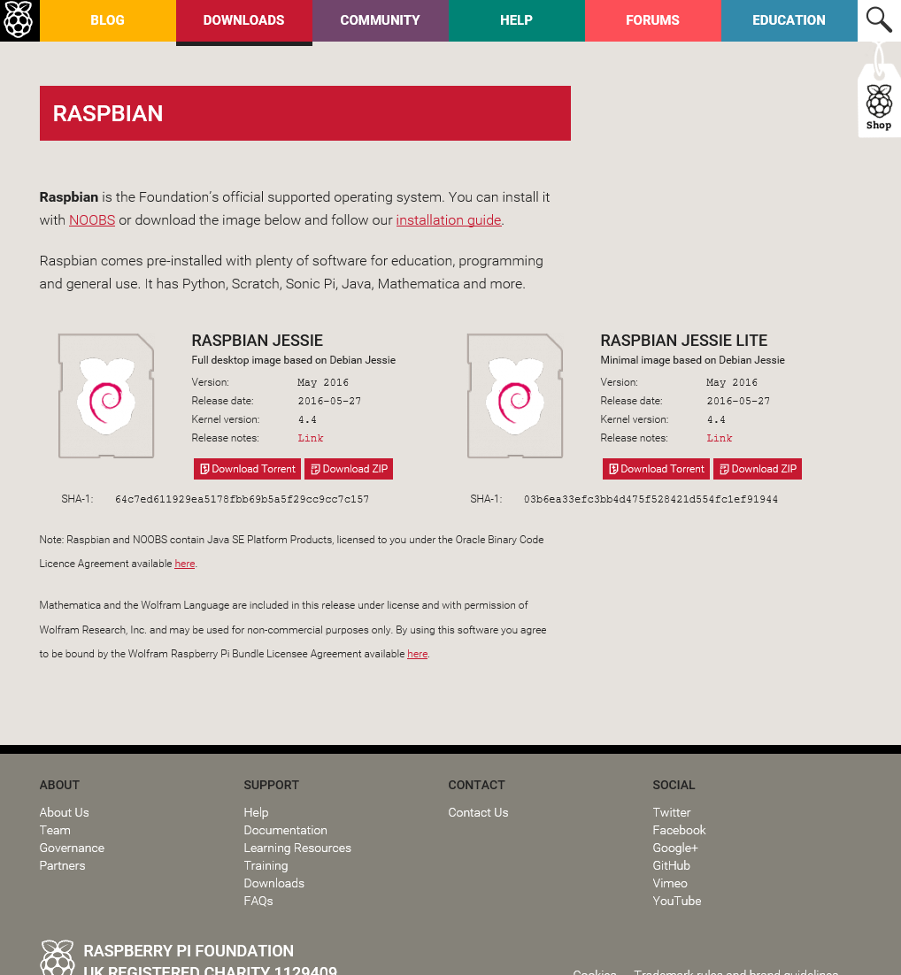
Install Raspbian
Download Raspbian image
https://www.raspberrypi.org/downloads/raspbian/

Slide 11
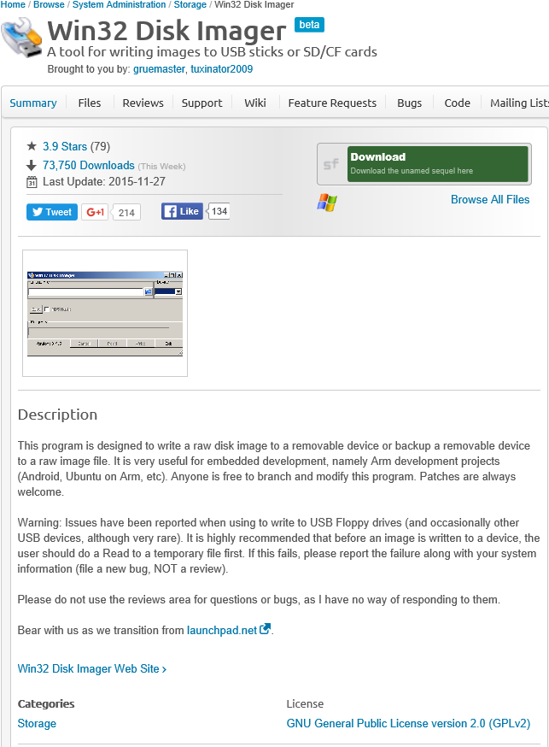
Install Raspbian
Download Win32 Disk Imager
https://sourceforge.net/projects/win32diskimager/

Slide 12
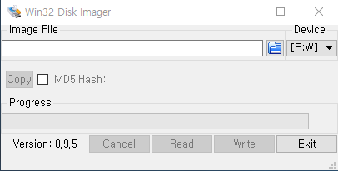
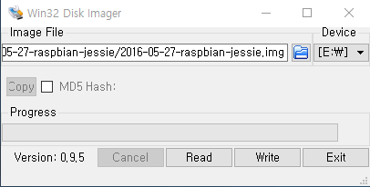
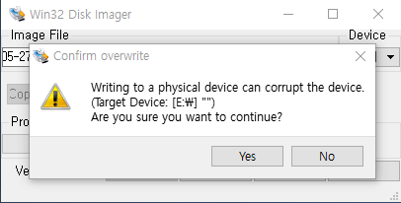
Install Raspbian
Write image on SD card
Execute Disk imager and set the location of image

Slide 13
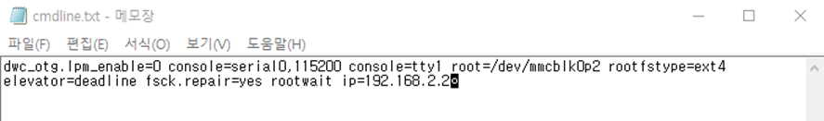
Install Raspbian
Configure Raspberry Pi
Connect your SD card to the PC and modify “cmdline.txt” file
Append your IP address behind “rootwait” (ip=192.168.2.2)
This is IP address for your Raspberry Pi

Slide 14
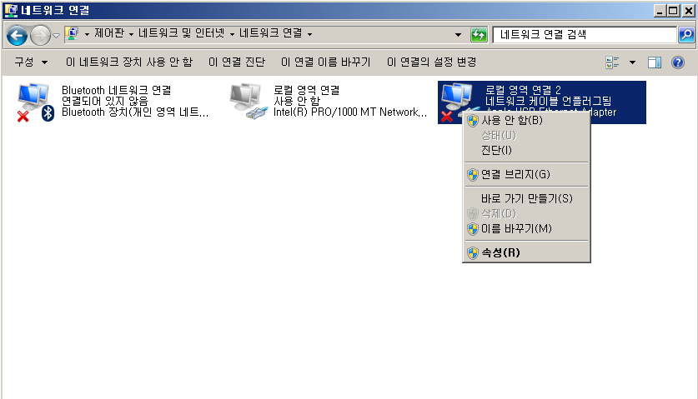
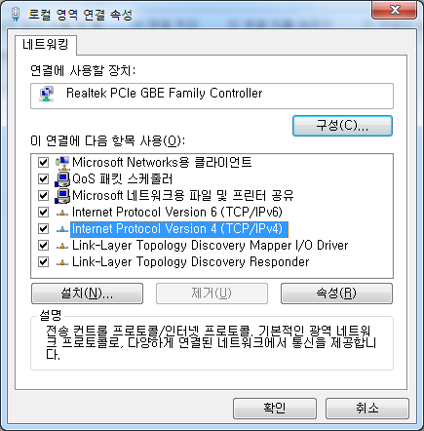
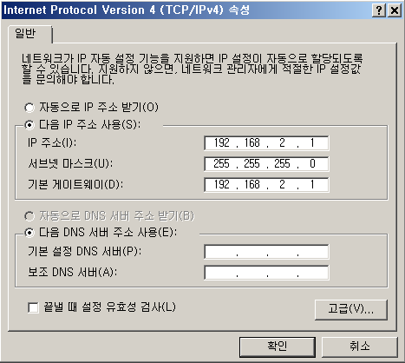
Install Raspbian
Configure your laptop
Open Network connections – Ethernet adapter – [Properties]
Click Internet Protocol Version 4(TCP/IPv4)’s Properties
Selects “Use the following IP address” and then change your IP address as below.

Slide 15
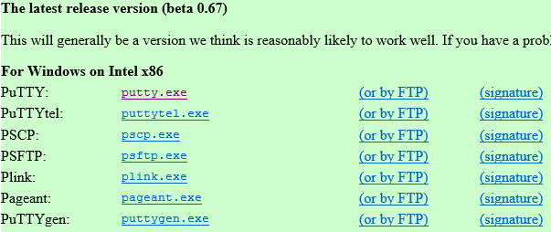
Install Raspbian
Download Putty
http://www.chiark.greenend.org.uk/~sgtatham/putty/download.html
Install putty.exe

Slide 16
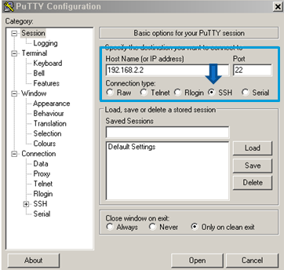
Install Raspbian
Connect Raspberry Pi and your laptop using Ethernet cable
Insert your SD card to your Raspberry Pi
Connect Raspberry Pi and your laptop using Ethernet cable
Power the Raspberry Pi on
Execute Putty
Type your IP address on the Host Name field
Save the session information
For your convenience...

Slide 17
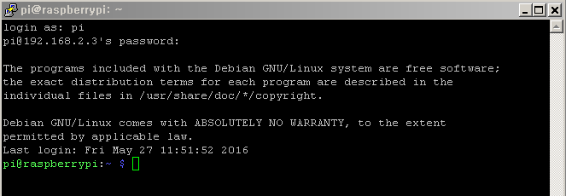
Install Raspbian
Access to the Raspberry Pi
ID : pi / PW : raspberry

Slide 18
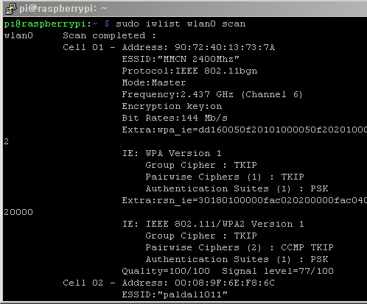
Install Raspbian
Configure wireless LAN
Check wireless LAN interfaces and Add wlan0 interface
sudo vi /etc/network/interfaces
Add below information
(if you already have this information skip)
Scan Network
sudo iwlist wlan0 scan
allow-hotplug wlan0
iface wlan0 inet dhcp
wpa-conf /etc/wpa_supplicant/wpa_supplicant.conf
iface default inet dhcp

Slide 19
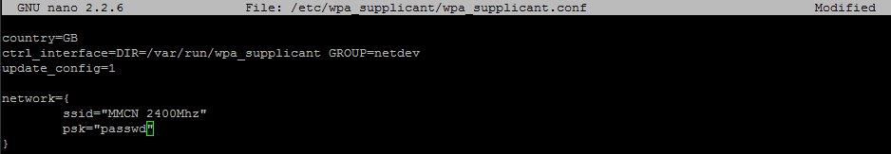
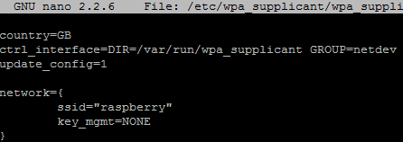
Install Raspbian
Configure Wireless LAN
Add wireless network information
sudo vi /etc/wpa_supplicant/wpa_supplicant.conf
If there are no password then type “key_mgmt=NONE”
Save the file and reboot
sudo reboot

Slide 20
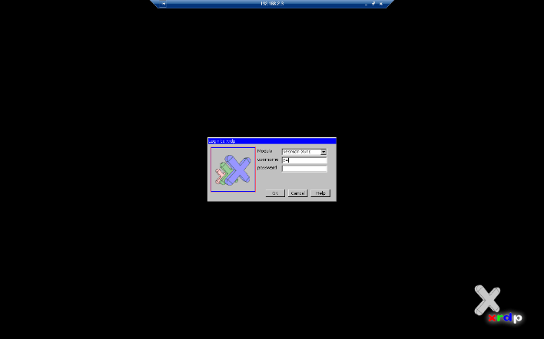
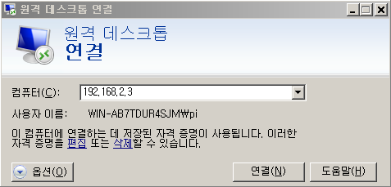
Configuring development environment
Configuring remote Desktop connection
xrdp
Open source remote access protocol based on RDP (Remote Desktop Protocol) which developed by Microsoft.
It provides remote access for the Raspberry Pi’s GUI environment
Install xrdp
Sudo apt-get install xrdp
Access the Raspberry Pi at the Window
Start menu-Search-Remote Desktop Connection and type ip/password
Notes:
RASPBIAN KITA 192.168.2.2

Slide 21
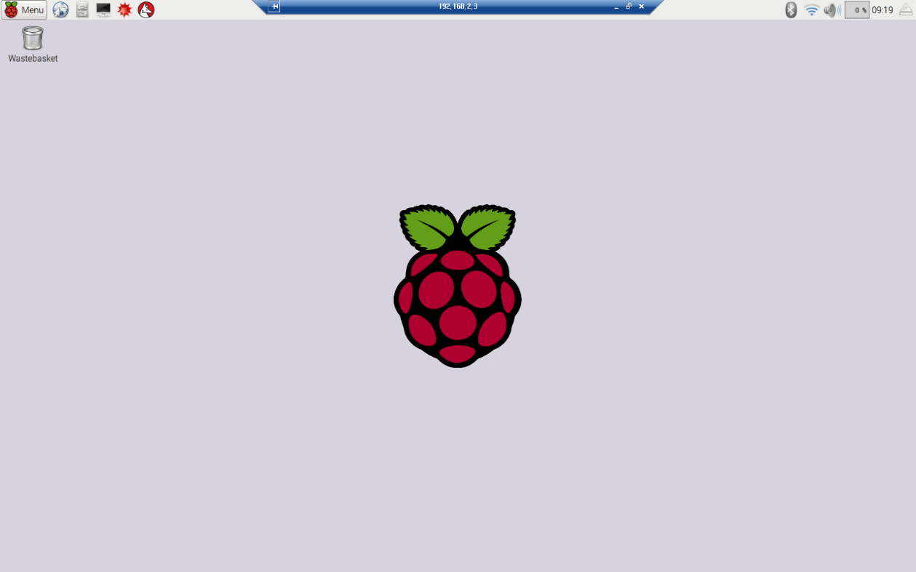
Configuring development environment
Now we can access the Raspberry Pi’s GUI environment remotely

